Slide 1
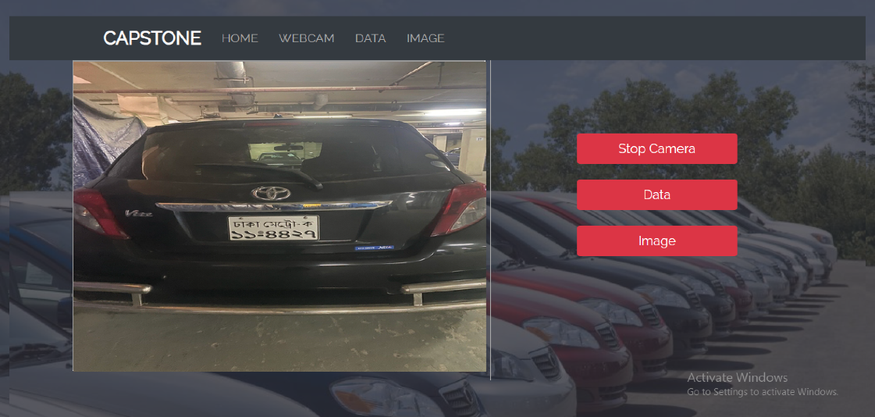
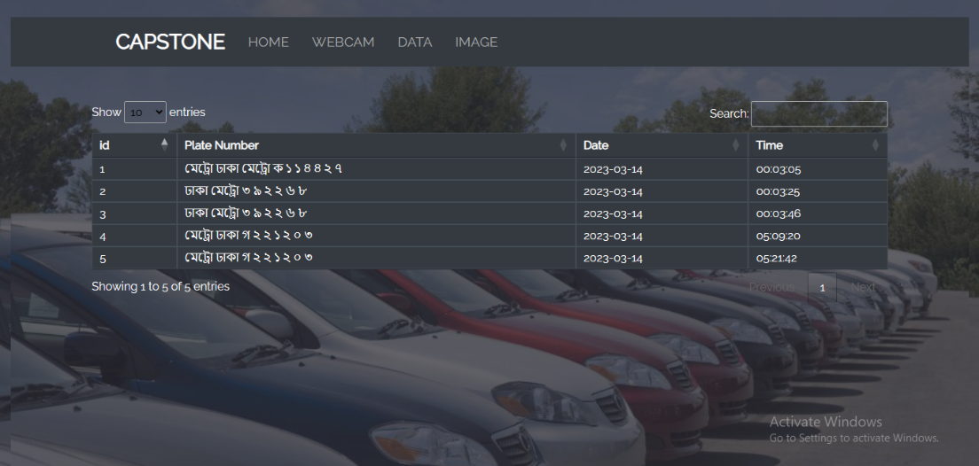
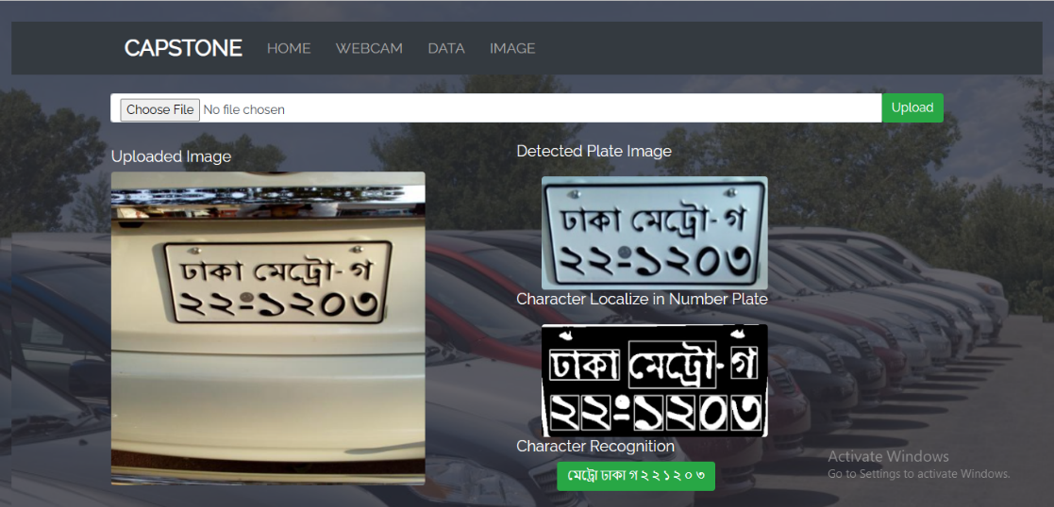






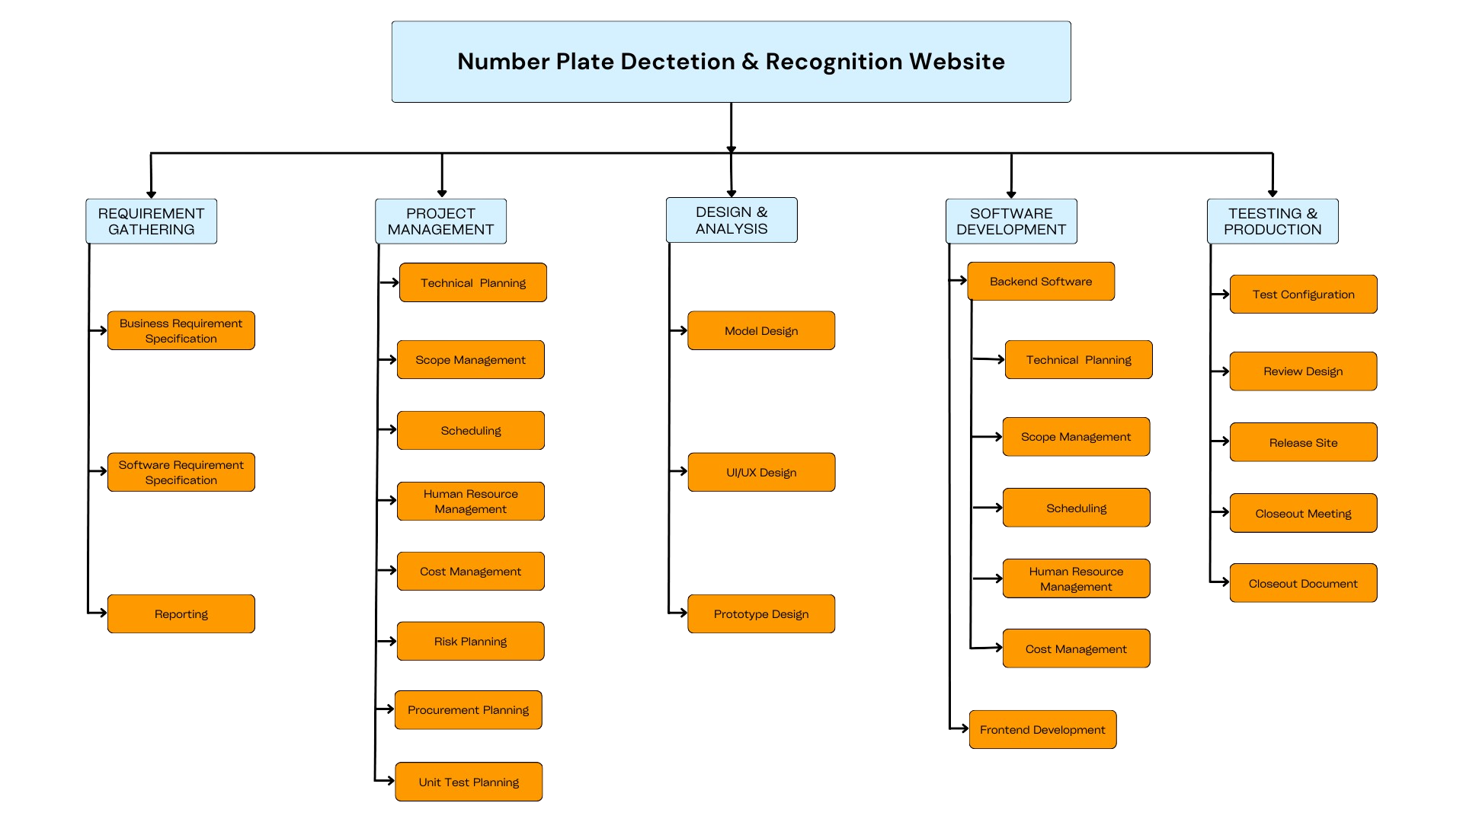
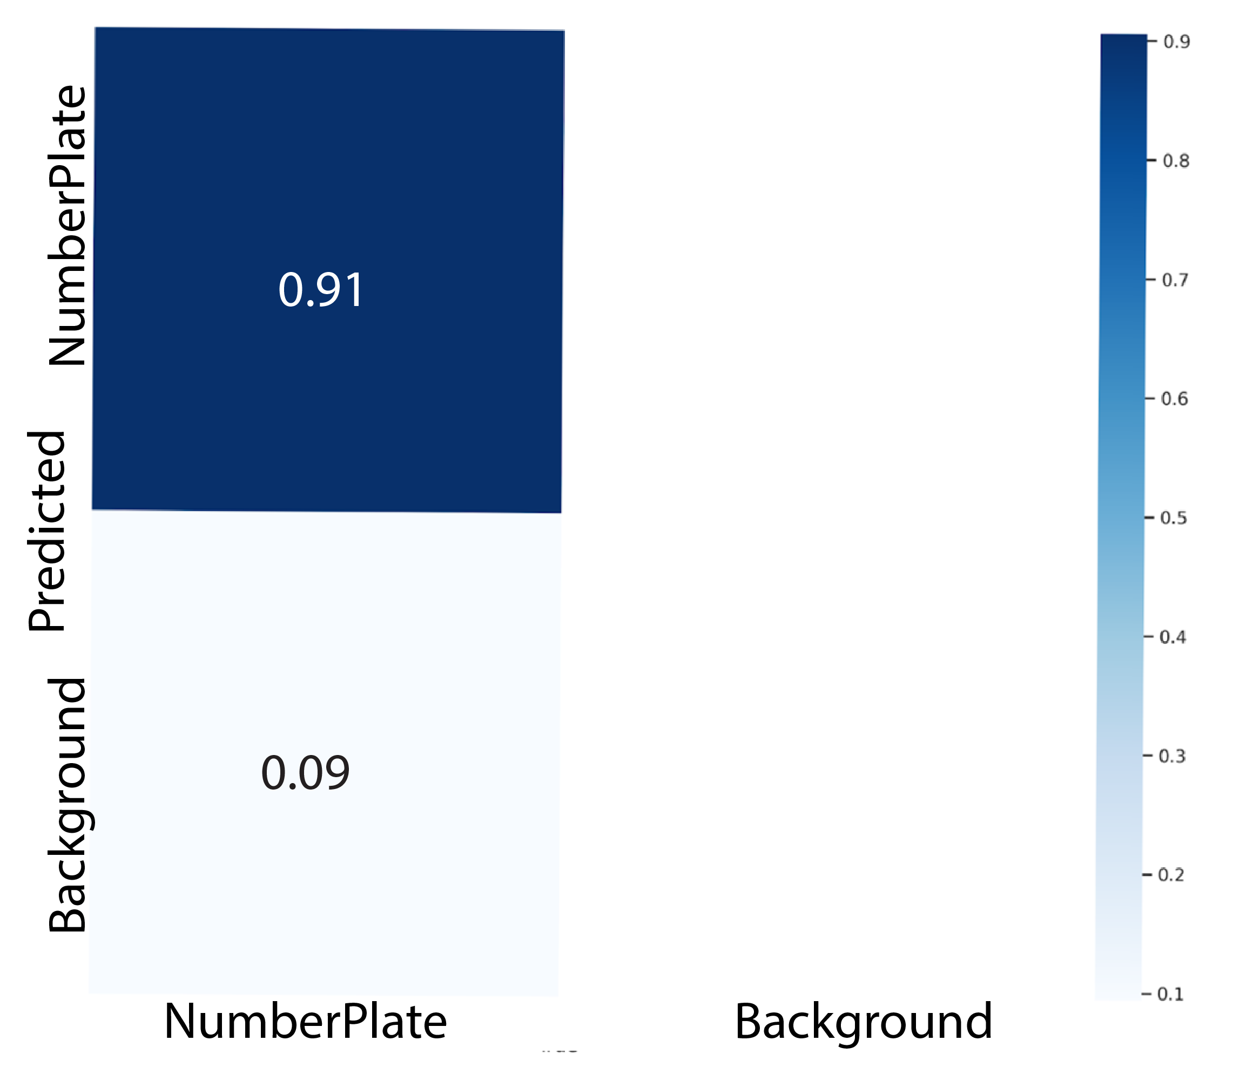
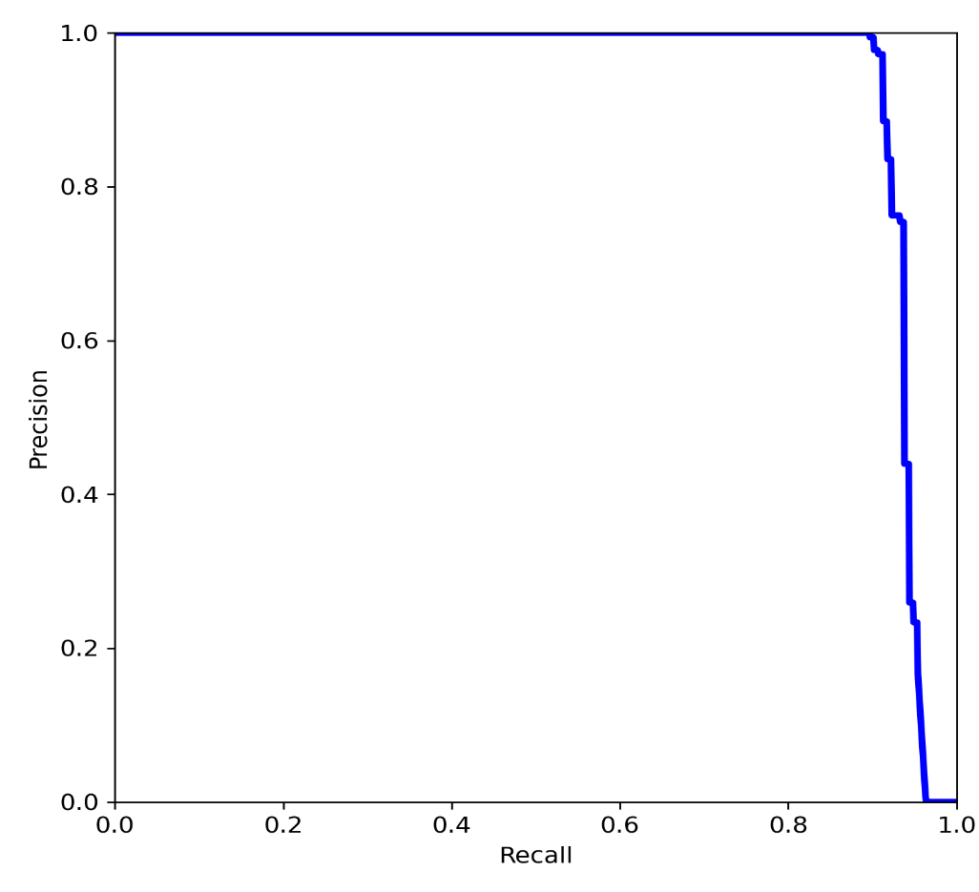
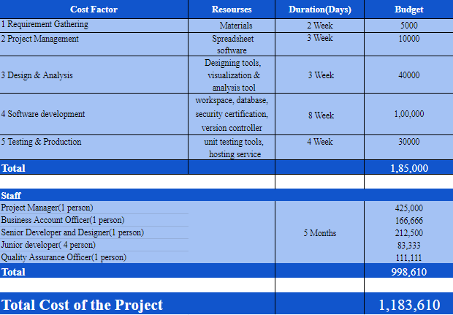
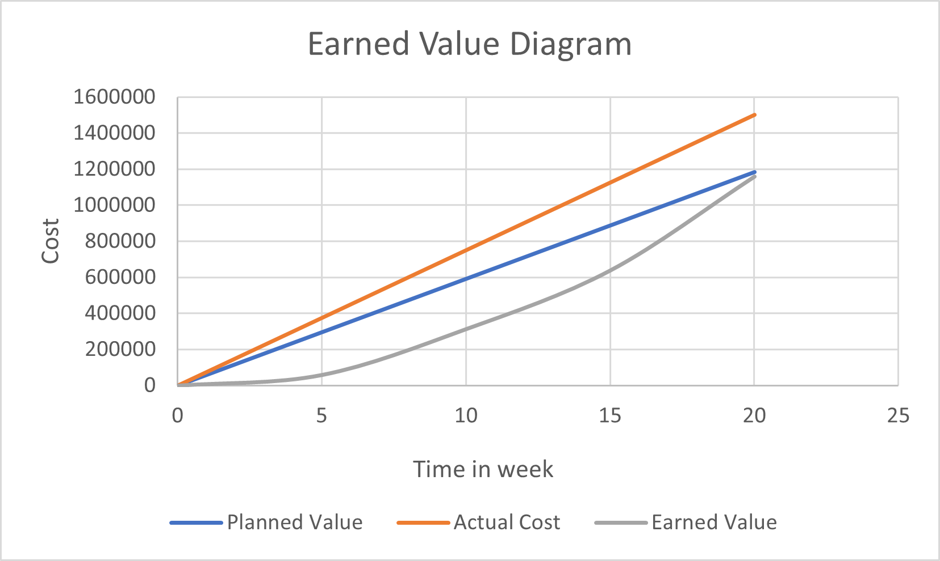
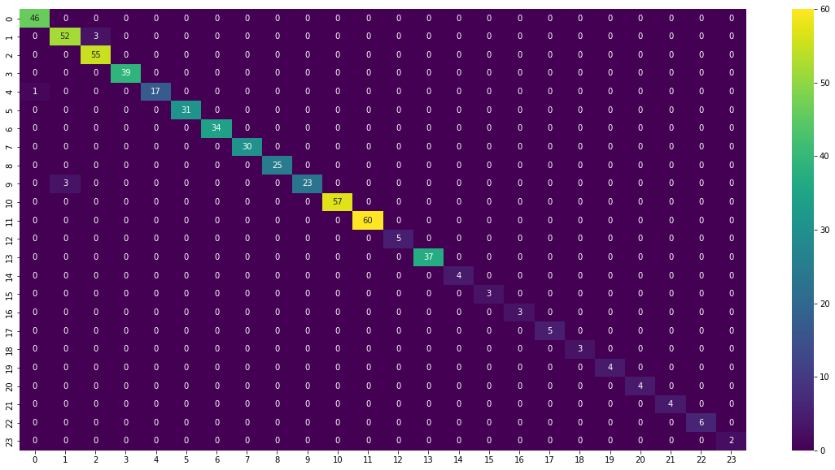
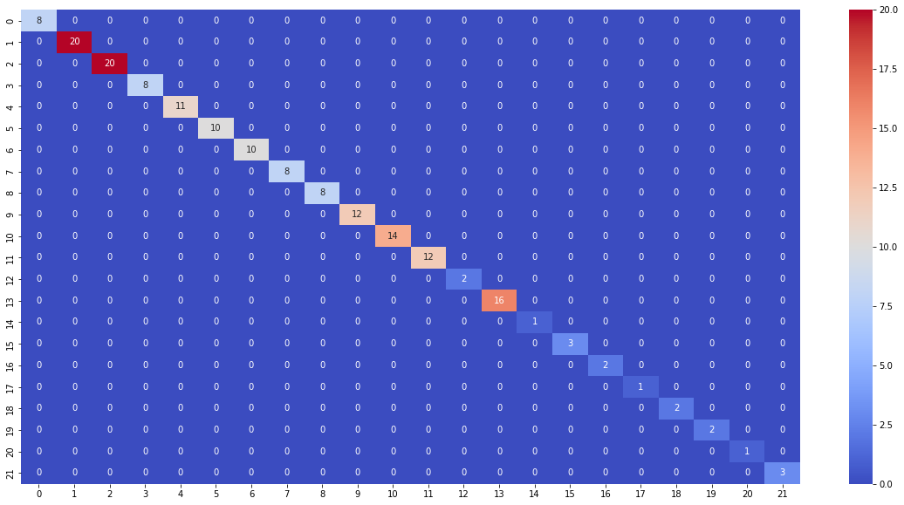
Automatic Bangla Digital Number Plate Detection & Recognition
System using Image Processing & Deep Learning
Noshin Faria, Plabon Banik , Amit Majumder, Adri Saha
Department of Computer Science & Engineering, East West University
OBJECTIVE
EXPERIMENTAL RESULT
IMPLEMENTATION OF WEBSITE
The principal objective of this study is
to propose a system that can detect and extract a number plate from an image,
localize characters, segment them from a number plate, and
Finally, recognize those characters to collect the license plate’s number.
Table 1: Experimental Results of Number Plate Detection
_{Model Name} | _{Accuracy} | _{Precision} | _{Recall} | _{mAP@.5} | _{mAP@0.5:0.95:}
_{YOLO V7} | _{0.91} | _{0.994} | _{0.901} | _{0.938} | _{0.827}
_{Image Processing Techniques} | – | _{0.936} | _{0.915} | – | –
METHODOLOGY
Used Technologies :
Table 2: Experimental Results of Character Localization Table 3: Experimental Results of Character Localization
_{Method} | _{Accuracy (%)}
_{YOLO V7} | _{91.38%}
_{Others(using same dataset)} | _{89.10%}
_{Precision} | _{Recall}
_{0.85} | _{0.97}
Table 4: Experimental Results of Character Localization
EARN VALUE MANAGEMENT
_{Model Name} | _{Loss} | _{Accuracy} | _{Precision} | _{Recall}
_{Inception} | _{0.3522} | _{0.8696} | _{0.8807} | _{0.8587}
_{VGG16} | _{0.5226} | _{0.9157} | _{0.9187} | _{0.8413}
_{VGG19} | _{0.5379} | _{0.9369} | _{0.9127} | _{0.9476}
_{Xception} | _{0.3726} | _{0.9026} | _{0.9539} | _{0.8261}
_{DenseNet} | _{0.3254} | _{0.8985} | _{0.8994} | _{0.8565}
_{Inception} | _{0.3574} | _{0.8312} | _{0.8801} | _{0.8220}
Figure 07: Work Breakdown Structure (WBS)
COST CALCULATION & EARNED VALUE DIAGRAM
Figure 04: Confusion Matrix of YOLO V7 model Figure 05: Precision recall curve of YOLO V7
Figure 01: Workflow Diagram
Figure 06: Confusion Matrix of VGG19 in train & test phase
Supervised By
References
Dr. Md. Nawab Yousuf Ali
Professor
Department of Computer Science and Engineering
East West University
Islam, R., Islam, M.R. and Talukder, K.H., 2020. An efficient method for extraction and recognition of bangla characters from vehicle license plates. Multimedia Tools and Applications, 79(27), pp.20107-20132
Chandra, S., Nowshad, M.A.A. and Islam, M.J., 2017, December. An automated system to detect and recognize vehicle license plates of Bangladesh. In 2017 20th International Conference of Computer and Information Technology (ICCIT) (pp. 1-6). IEEE.
Shaifur Rahman, M.M., Shamima Nasrin, M., Mostakim, M. and Zahangir Alom, M., 2018. Bangla License Plate Recognition Using Convolutional Neural Networks (CNN). arXiv e-prints, pp.arXiv-1809.
Islam, M.A., Chowdhury, G.M. and Haque, M.N.M., 2021, May. Bangla License _{Plate} Detection, Recognition and Authentication with Morphological Process and Template Matching. In 2021 2nd International Conference for Emerging Technology (INCET) (pp. 1-6). IEEE.

